Slide 1

Emotional Response Robot using Raspberry Pi 4
Section: 2341-2O3
Group No: 10
Robotics Programming Workshop -1 (CSE 3197)
Arjumand Khan (2341011060)
Aima Aftab (2341001034)
Sanjana Baral (2341002031)
Yasolipsa Bhoi (2341002177)
Amarjeet Ranjan (2341018075)
Ankit Pritam Mallick (2341013084)
Under the supervision of:
Dr. Shaktijeet Mohapatra and
Dr. Bhanja Kishor Swain
Centre for IoT, ITER, Siksha ‘O’ Anusandhan (Deemed to be University), Bhubaneswar

Slide 2
Contents
Aim
Introduction
Literature Survey
Project Objectives
Block Diagrams
Circuit Diagram
Components
References
Conclusion

Slide 3
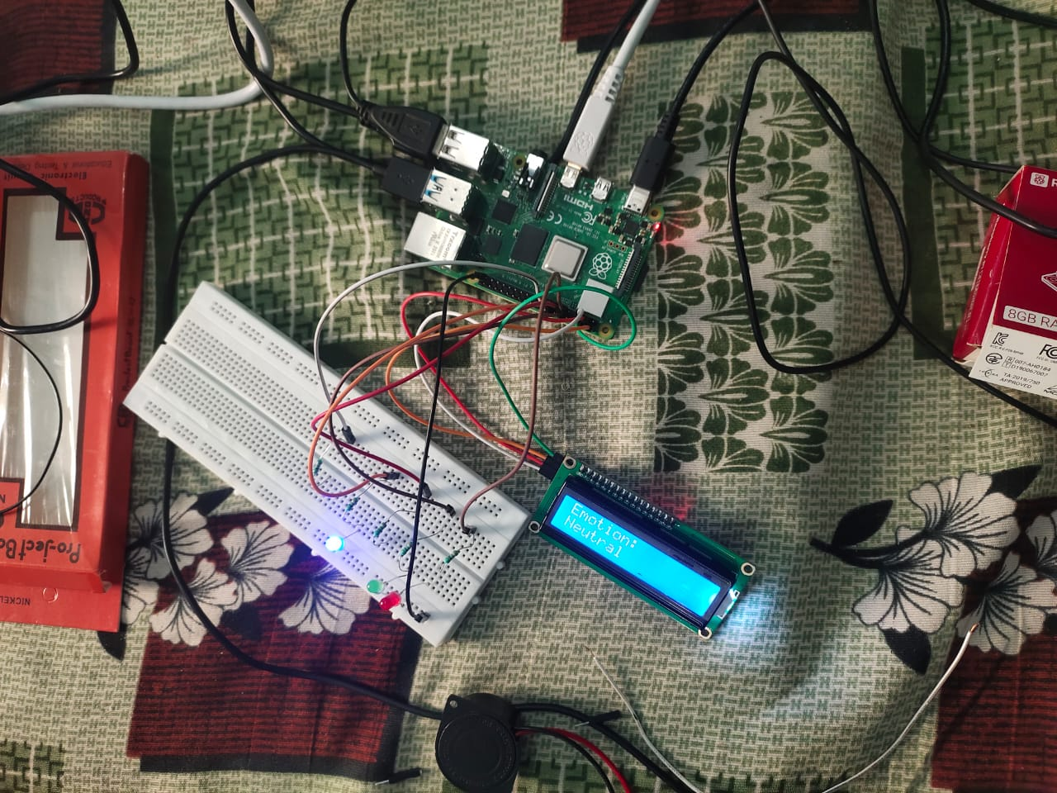
Aim
To design and implement an intelligent robot using Raspberry Pi 4 that detects human emotions from facial expressions in real-time and displays the detected emotion accordingly.

Slide 4
Introduction
Emotion Detection:
It is a part of affective computing, which focuses on recognizing human emotions.
Autonomy System:
The system operates autonomously to detect faces and classify emotions.
Core Mechanism:
A Raspberry Pi with a camera module captures live video input.
Computer vision techniques and neural networks are used for emotion classification.
Applications:
Applications include healthcare monitoring, education, human-robot interaction, and customer service.

Slide 5
Literature Survey
Facial Expression Recognition Systems:
Facial expression recognition systems commonly use Convolutional Neural Networks (CNNs).
Raspberry Pi in Robotics:
Raspberry Pi is widely used in robotics due to its GPIO support, camera compatibility, and portability.
Emotion Detection Applications:
Used in customer service, healthcare, education, and human-robot interaction.

Slide 6
Project Objectives
1. Detect human faces using a camera module.
2. Classify emotions using a trained neural network (e.g., TensorFlow/Keras).
3. Build a robot platform that interacts based on detected emotion.
4. Display emotion results on an interface (LCD/monitor) and optionally generate audio feedback.

Slide 7
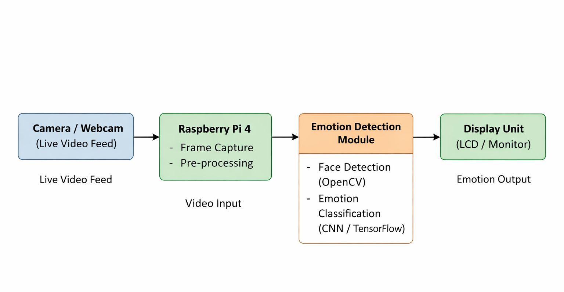
Block Diagram

Slide 8
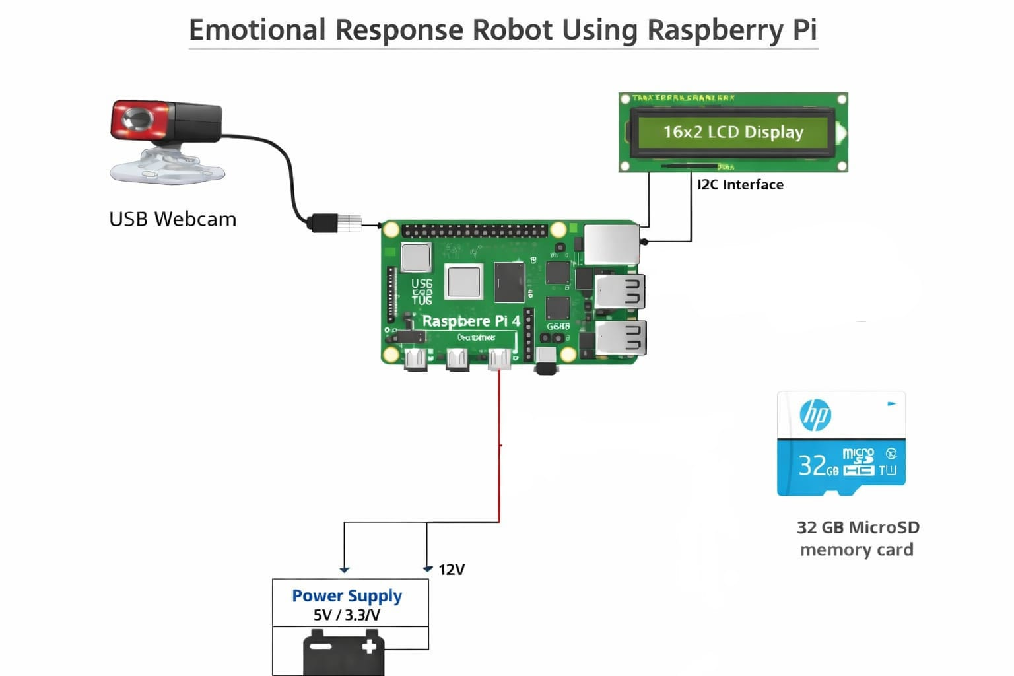
Circuit Diagram

Slide 9
Components Required and Purposes
Raspberry Pi 4: Main processing unit for running emotion detection model.
Webcam / Camera Module: Captures live facial images.
16×2 LCD Display / Monitor: Displays detected emotion.
MicroSD Card (32 GB): Stores operating system and program files.
Breadboard & Connecting Wires: Hardware connections.
Power Supply: Provides power to Raspberry Pi.

Slide 10
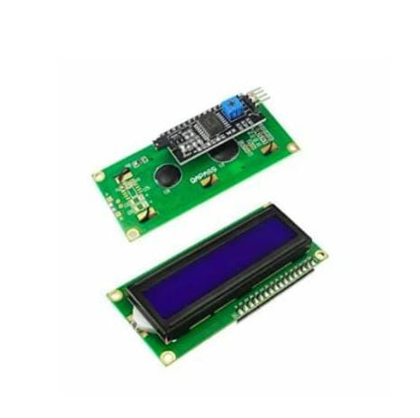

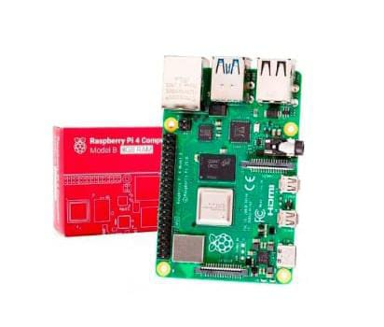
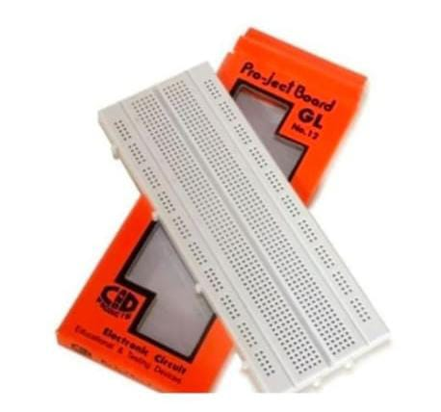
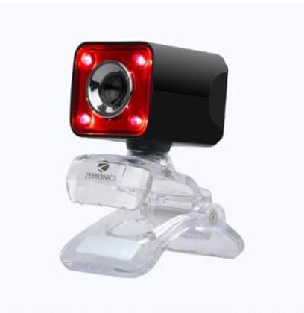
Pictures of Components
Raspberry Pi 4
16 X 2 LCD Display
32 GB MicroSD memory card
GL-12 BreadBoard
Web Cam

Slide 11
Conclusion
The emotion detection robot using Raspberry Pi successfully recognizes and classifies human emotions in real-time.
This project demonstrates the effective integration of computer vision and embedded systems for improved human-machine interaction and can be extended for advanced robotic applications.

Slide 12
References
C. Shan, S. G. Gong, P. W. McOwan: Facial Expression Recognition Based on Local Binary Patterns
OpenCV Documentation: https://opencv.org/
TensorFlow Tutorials: https://www.tensorflow.org/
Raspberry Pi Foundation Documentation: https://www.raspberrypi.org/

Slide 13
THANK YOU

